Slide 1
Lecture LA01: ASP.NET Pages
ITP271: Web Application Development & Project

Slide 2
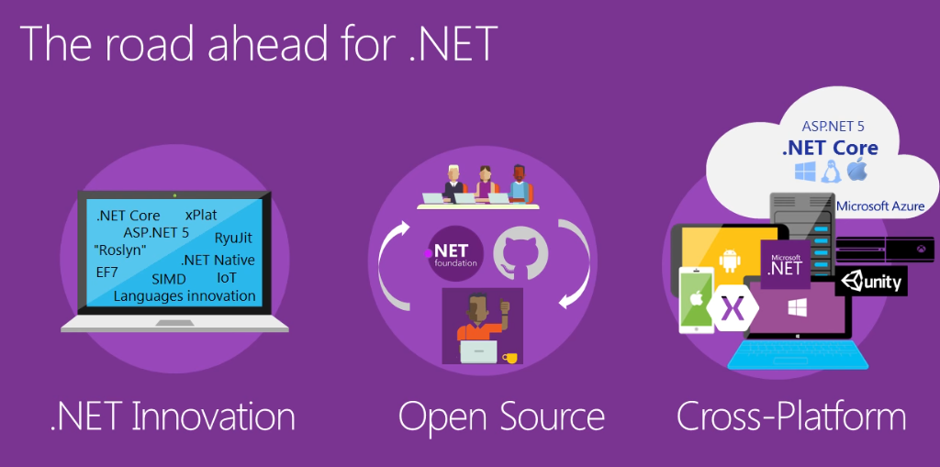
Overview
To make sense of ASP.NET pages, we need to understand the following:
  Introduce ASP.NET
  ASP.NET Framework
  ASP.NET Web Form
    Page directives,Server Control, Web Page Code Model
  ASP.NET Event Handler

Slide 3
What is ASP.NET?
ASP.NET is a server-side programming technology that enables scripts (embedded in web pages) and code (written in C#, VB.NET or J#) to be executed by an Internet server
  ASP.NET is a program that runs inside Internet Information Services (IIS)
  ASP.NET is a Microsoft Technology
  Check it out .NET 2015 Improvements:
  https://www.youtube.com/watch?v=I6SU7UTaA3E

Slide 4
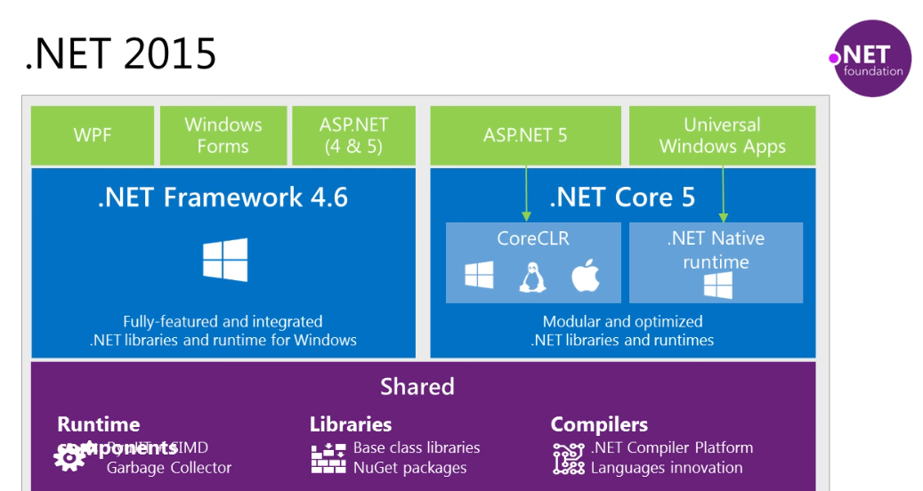
.NET Framework
The .NET Framework is the infrastructure for the Microsoft .NET development platform
The .NET Framework is an environment for building, deploying, and running Web applications and Web Services, as well as Windows desktop applications

Slide 5
.NET Framework
The .NET Framework consists of 3 main parts:
  Programming languages:
    C# (Pronounced “C sharp”)
    Visual Basic (VB.NET)
    J# (Pronounced “J sharp”)
  Server technologies and client technologies:
    ASP .NET (Active Server Pages)
    Windows Forms (Windows desktop solutions)
    Compact Framework (PDA / Mobile solutions)
  Development environments:
    Visual Studio
    Visual Web Developer Express (free version of Visual Studio with less features)

Slide 6
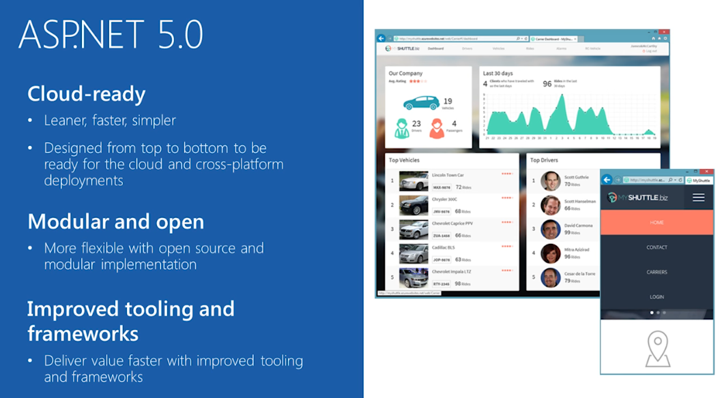
ASP.NET 5.0

Slide 7
ASP.NET Web Form
An ASP.NET Web Form consists of the following:
  Web content page
    Directive
    ASP.NET server controls
    Literal text and HTML tags
    Client side java script
  Programming logic for the page
It is basically a text file that have the .aspx file name extension and we can develop our web application using Visual Basic (VB) or C#.

Slide 8
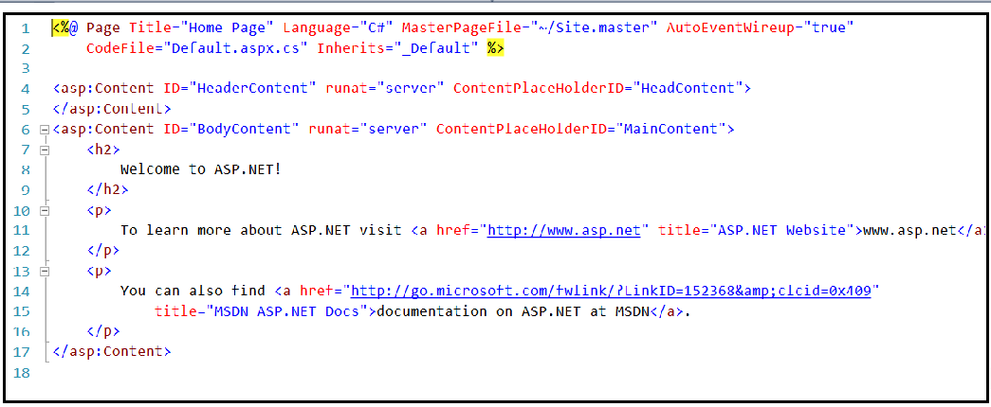
ASP.NET Web Form
ASPX source code of design page
Page Directive
ASP Control
HTML

Slide 9
Page Directives
Directives specify settings that are used by the page when the compilers process ASP.NET pages. Mainly:
Programming Language used
Master page used
Name of back end code file

Slide 10
Server Controls
Three basic types
  Web Server Controls
    Basic web control such as Textbox, Button etc
    Validation control
    Rich control such as Calendar, AdRotator etc
    List control supports binding to data collection
  HTML Controls
    HyperText Markup Language (HTML) elements that include a runat=server attribute
  User Control
    Reuse the user interface of Web Form
Notes:
In this module, it will cover more on Web server controls

Slide 11
Advantages of Server Controls
Easy to read/write to HTML element properties
It retain properties value by default using a mechanism known as View State.
Many controls can be bound to data with minimum coding

Slide 12
ASP.NET Web Page Code Model
Programming logic for the page includes event handlers and other code
ASP.NET provides two
  Single-file page model and
  Code-behind page model.

Slide 13
Code Behind Page Model
ASP.NET 2.0 and later offer a code behind file for each page to separate content and logic
Code behind file is named with the extension of aspx.cs
Code-behind file contains class definition for the page
  This is what Default.aspx.cs looks like:
<%@ Page Title="Home Page" Language="C#" AutoEventWireup="true"
CodeFile="Default.aspx.cs" Inherits="_Default" %>
public partial class _Default : System.Web.UI.Page
{
protected void Page_Load(object sender, EventArgs e)
{
}
}
The .cs page contains only c# code

Slide 14
Single File Page Model
A block for inserting application logic code within the .aspx page.
  Starts with <script runat="server">
  Ends with </script>
  Code is in the language declared in the Page Directive.
  Code in Code Declaration Block is executed only when it is triggered or called
  Not a good practice, but something you should know about

Slide 15
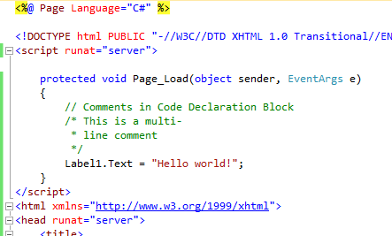
Example -Single File Page Model
Insert c# code here

Slide 16
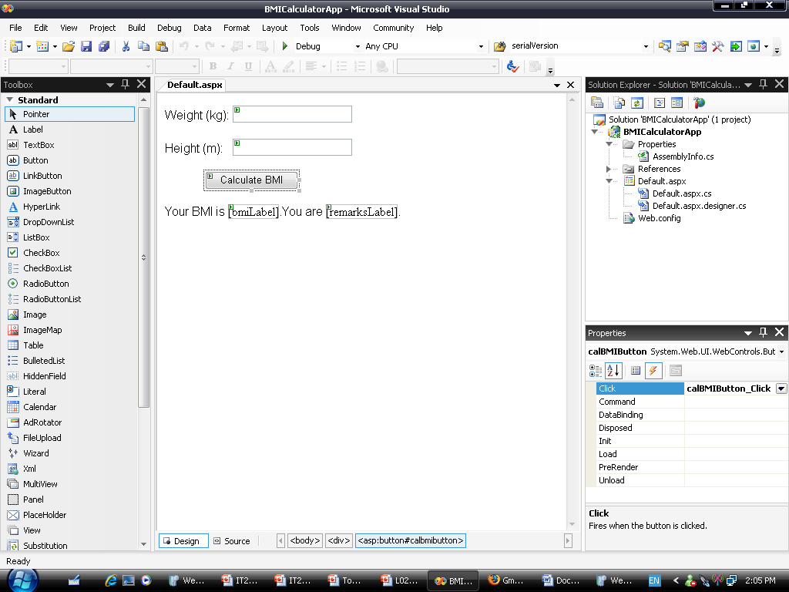
ASP.NET Event Handler
Event are caused by user action
An Event Handler is a subroutine that executes code for a given event
Event handlers are automatically named with format
  ObjectName_EventName
Event-handling
Method / function
Event

Slide 17
ASP.NET Event-Handling Methods
It is a set of statements beginning with a function header
Method statements are enclosed in braces {}
Basic event-handling method syntax
For example
protected void mButton_Click(object sender, EventArgs e)
{
// Do something
}

Slide 18
Page_Load Event
Page_Load event is triggered when a page loads the content
ASP.NET will automatically call the subroutine Page_Load
protected void Page_Load(object sender, EventArgs e)
{
lbl1.Text="The date and time is " & now() ;
}

Slide 19
Postback
The Page_Load event runs EVERY time the page is loaded.
If you want to execute the code in the page load only the First time, you can use Page. IsPostBack property
If IsPostBack property is false, means that the page is loaded for the first time
if (IsPostBack == false)
{ ageList = new List<ListItem>();
ageList.Add(new ListItem("35 - 45", "35"));
ageList.Add(new ListItem("Above 45", “45"));
}

Slide 20
Summary
We have covered
  ASP Page structure
  Web Page Coding Model
  ASP.NET Event Handler
The above provides us with foundation to understand ASP.NET web pages

